Slide 1
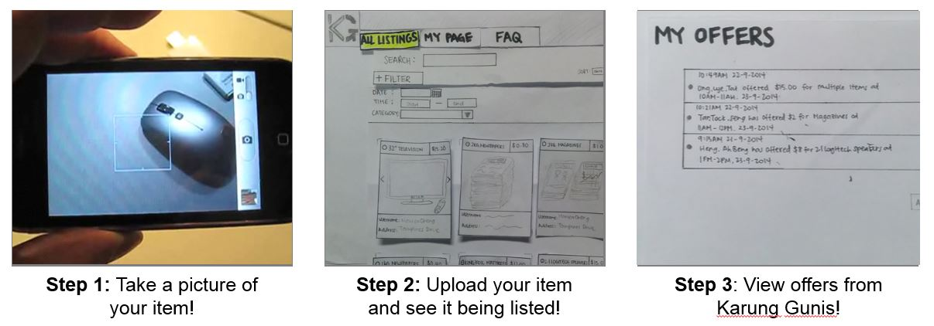
Karung Guni Application
Buy & Sell your recyclable items now!
In 3 simple easy steps:

Slide 2
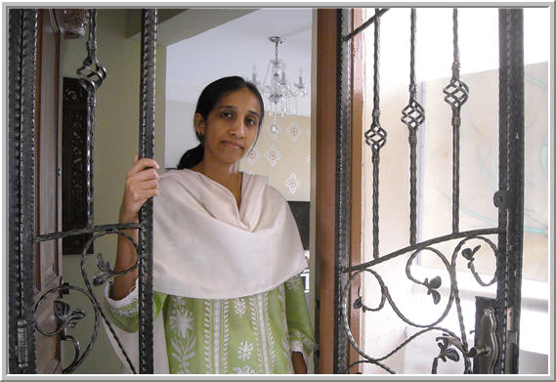
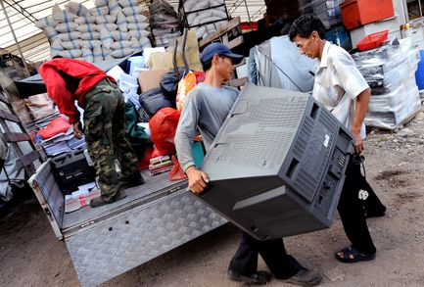
Choose a user type
Seller
Buyer

Slide 3
REGISTER - SELLER
Please select your preferred timings
Username/E-mail:
M | T | W | T | F | S | S
Password:
9AM – 12PM
Confirm Password:
12PM – 3PM
Name:
3PM – 6PM
Contact:
6PM – 9PM
Address: Blk
Unit:
Road:
Submit
Cancel
Postal Code:

Slide 4
REGISTER - SELLER
Username/E-mail:
Password:
Confirm Password:
Name:
Contact:
Address: Blk
Unit:
Road:
Submit
Cancel
Postal Code:

Slide 5
EDIT PROFILE
Please select your preferred timings
Username/E-mail:
M | T | W | T | F | S | S
Password:
9AM – 12PM
Confirm Password:
12PM – 3PM
Name:
3PM – 6PM
Contact:
6PM – 9PM
Address: Blk
Unit:
Road:
Update
Cancel
Postal Code:

Slide 6
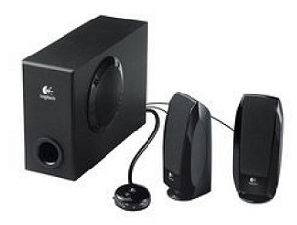

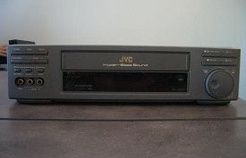
All Listings
List of Items
Search:
Sort by:
Category:
ALL
Seller Availability
Date:
Time:
2.1 LOGITECH SPEAKERS Category: Electronics Condition: 8 Price: 34.5 Description: Item is in great shape Seller: MonicaCheng@hotmail.com
OLD NEWSPAPERS Category: Newspapers/Cardboards Condition: 10 Price: 7 Description: Straits Times, Newpaper from the past 3 months. Weight is close to 15kg Seller: MonicaCheng@hotmail.com
SPOILT VCR Category: Electronics Condition: 2 Price: 5 Description: VCR is over 10 years old & is no longer usable. However, parts are still intact. Seller: uncleDesmond@conman.com

